Slide 1
Mathematics for Analytics and Finance
Sami Najafi
MSIS2402/2405
Module 5

Slide 2
Events and their Probabilities

Slide 3
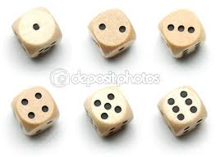


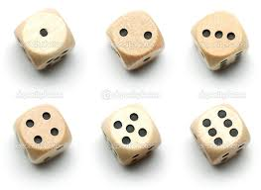



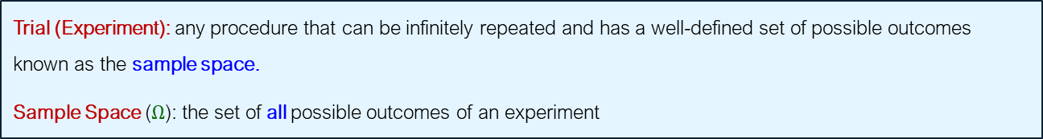
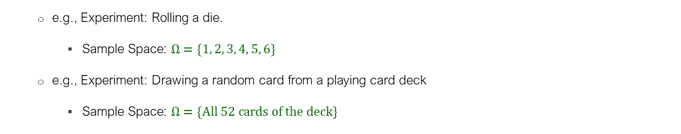
Events and Sample Space
Trial (Experiment): any procedure that can be infinitely repeated and has a well-defined set of possible outcomes known as the sample space.
Sample Space ($Ω$): the set of all possible outcomes of an experiment
e.g., Experiment: Rolling a die.
Sample Space: $Ω=\{1, 2, 3, 4, 5, 6\}$
e.g., Experiment: Drawing a random card from a playing card deck
Sample Space: $Ω=\{All 52 cards of the deck\}$
Event: is a subset of the sample space
e.g., In rolling a die: $A=\{1, 2\}$ is the event that the outcome is $1$ or $2$

Slide 4



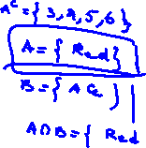

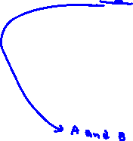


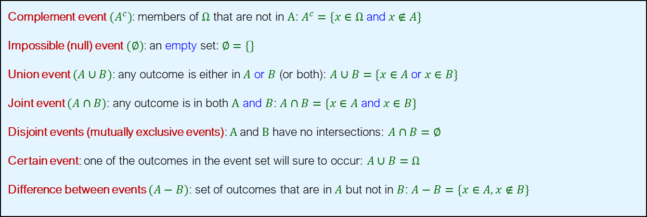
Events as Sets
Complement event $(A^{c})$: members of $Ω$ that are not in $A$: $A^{c}=\{x∈Ω \text{and} x∉A\}$
Impossible (null) event $(∅)$: an empty set: $∅=\{\}$
Union event $(A∪B)$: any outcome is either in $A$ or $B$ (or both): $A∪B=\{x∈A \text{or} x∈B\}$
Joint event $(A∩B)$: any outcome is in both $A$ and $B$: $A∩B=\{x∈A \text{and} x∈B\}$
Disjoint events (mutually exclusive events): $A$and $B$ have no intersections: $A∩B=∅$
Certain event: one of the outcomes in the event set will sure to occur: $A∪B=Ω$
Difference between events $(A−B)$: set of outcomes that are in $A$ but not in $B$: $A−B=\{x∈A, x∉B\}$

Slide 5
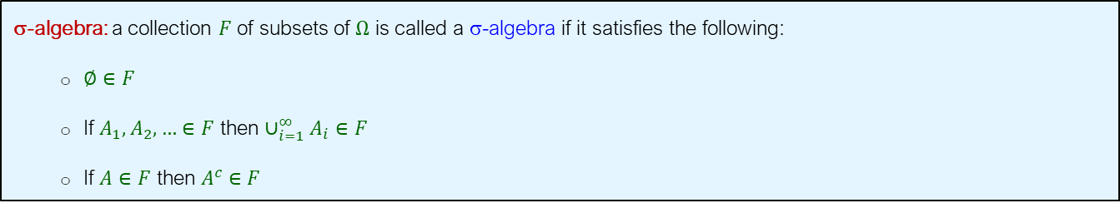
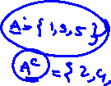


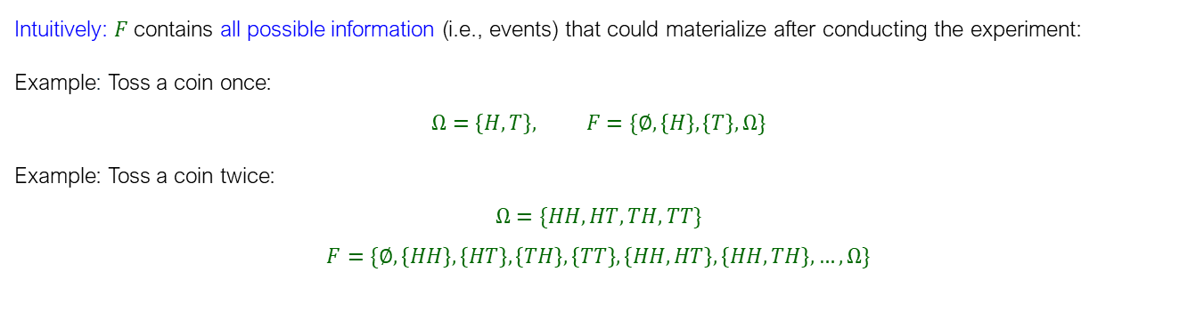




Sigma Algebra (σ-algebra)
σ-algebra: a collection $F$ of subsets of $Ω$ is called a σ-algebra if it satisfies the following:
$∅∈F$
If $A_{1},A_{2},…∈F$ then ${∪_{i=1}^{∞}A}_{i}∈F$
If $A∈F$ then $A^{c}∈F$
Intuitively: $F$ contains all possible information (i.e., events) that could materialize after conducting the experiment:
Example: Toss a coin once:
$$Ω=\left\{H,T\right\}, F=\{∅,\left\{H\right\},\left\{T\right\},Ω\}$$
Example: Toss a coin twice:
$$Ω=\{HH,HT,TH,TT\}$$
$$F=\{∅,\left\{HH\right\},\left\{HT\right\},\left\{TH\right\},\left\{TT\right\}, \left\{HH,HT\right\},\left\{HH,TH\right\},…,Ω\}$$

Slide 6

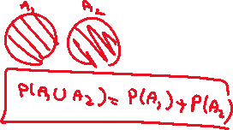





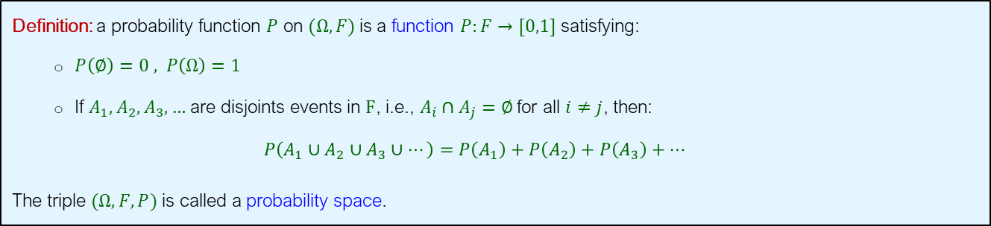
Probability Function
Definition: a probability function $P$ on $(Ω,F)$is a function $P:F→[0,1]$ satisfying:
$P\left(∅\right)=0 , P\left(Ω\right)=1$
If $A_{1},A_{2},A_{3},…$ are disjoints events in $F$, i.e., $A_{i}∩A_{j}=∅$ for all $i≠j$, then:
$$P\left(A_{1}∪A_{2}∪A_{3}∪…\right)=P\left(A_{1}\right)+P\left(A_{2}\right)+P\left(A_{3}\right)+…$$
The triple $(Ω, F,P)$ is called a probability space.
Remark: In many cases especially in games of chance it is natural to assume that all outcomes are equally likely. In such a case the probability of an event $A$is
$$P\left(A\right)=\frac{n\left(A\right)}{n\left(Ω\right)}=\frac{\text{Number} \text{of} \text{outcomes} \text{in} A }{\text{Number} \text{of} \text{outcomes} \text{in} Ω}=\frac{\text{Number} \text{of} \text{desired} \text{outcomes} }{\text{Total} \text{number} \text{of} \text{outcomes}}$$

Slide 7



Example
Find the probability of selecting a face card (Jack, Queen, or King) from a standard deck of 52 cards.
$FC$: The event that a face card is selected
$Ω$: The event that any card is selected
$$P(A)=\frac{n(FC)}{n(Ω)} = \frac{12}{52}=\frac{3}{13}$$
This is an example of a priori probability, which means it’s calculated purely based on logical deduction and the known structure of the deck, without relying on past data. A priori probabilities are useful when you know the possible outcomes and their counts without needing historical data.

Slide 8


Example
Find the probability of selecting a male taking statistics from the population described in the below table:
 | Taking Stats | Not Taking Stats | Total
Male | 84 | 145 | 229
Female | 76 | 134 | 210
Total | 160 | 279 | 439
$$P\left(M\right)\text{=}\frac{n\left(M\right)}{n\left(Ω\right)}=\frac{84}{439}≈0.191$$
This is an example of empirical probability, calculated from actual data rather than theoretical assumptions. Empirical probability is often used in business when making predictions based on historical data.

Slide 9





Visualizing Events
Contingency Table: A contingency table (also known as a cross-tabulation or crosstab) is a matrix that displays the frequency distribution of two or more variables simultaneously. Each cell in the table shows the frequency (or the probability) of a particular combination of outcomes for the two variables (joint event)
Ace Not Ace Total
Black 2 24 26
Red 2 24 26
Total 4 48 52
Sample Space
Contingency tables are widely used in business analytics to examine relationships between two variables, like customer demographics (age, income) and purchase behavior (purchase, no purchase). They help identify patterns, such as whether a particular age group is more likely to buy a product.

Slide 10


Visualizing Events
Decision Tree: A decision tree is a visual representation that breaks down events or decisions into a series of steps, using nodes and branches. It starts with a root node that represents the sample space. From the root node, branches extend to other nodes representing subsequent outcomes. The leaves or terminal nodes represent final outcomes, complete with associated frequencies or probabilities.
Ace
2
24
2
24
Sample Space
Black Card
Not an Ace
Full Deck of 52 Cards
Ace
Red Card
Not an Ace
Decision trees are valuable for analyzing sequential decisions and conditional probabilities, common in business.

Slide 11









Visualizing Events
Venn Diagram: A Venn diagram is a visual tool to illustrate the relationships between different sets (or events) within a sample space. The sample space is shown with the outer rectangle and includes all the outcomes shown using common shapes (e.g., circles, rectangles, etc). Overlapping shapes are joint events.
$$Ace ∩ Red$$
$$Sample Space (Ω)$$
$$Black$$
$$Red$$
$$Ace$$
$$24$$
$$2$$
$$2$$
$$24$$
Venn diagrams are often used in business to analyze overlapping customer segments, such as customers interested in both Product A and Product B.

Slide 12




Mutually Exclusive Events
Mutually exclusive (or disjoint) events: are events that cannot occur simultaneously.
Example: Drawing one card from a deck of cards
$A$ = queen of diamonds; $B$ = queen of clubs
Events $A$ and $B$ are mutually exclusive: $P\left(A ∩ B\right)=0$

Slide 13
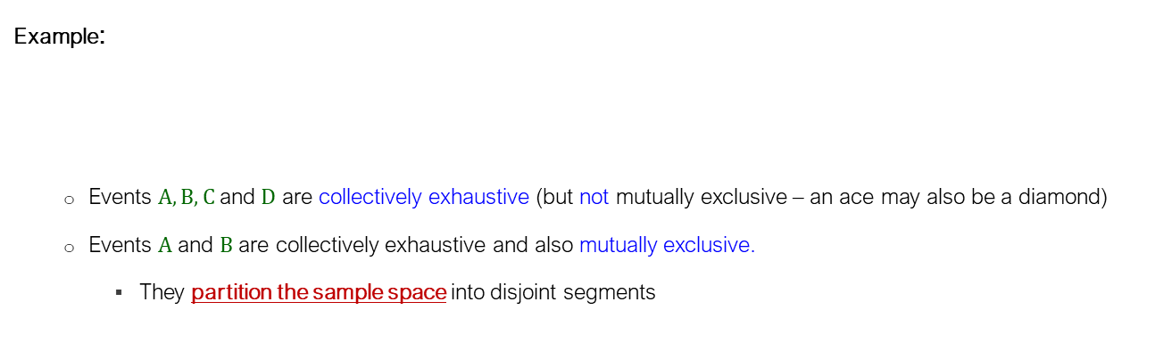

Collectively Exhaustive Events
Collectively exhaustive events: A set of events that together cover all possible outcomes of an experiment in the sample space. In other words, at least one event from the set must occur whenever the experiment is conducted.
Example:
Events $A, B, C$and $D$ are collectively exhaustive (but not mutually exclusive – an ace may also be a diamond)
Events $A$ and $B$ are collectively exhaustive and also mutually exclusive.
They partition the sample space into disjoint segments
$A$ = red cards; $B$ = black cards;
$C$ = diamonds; $D$ = clubs

Slide 14
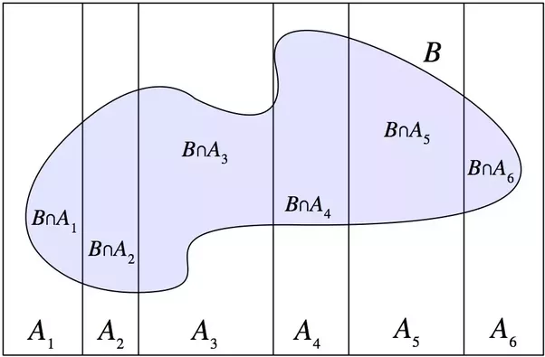
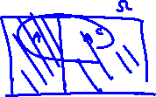



Partitions of a Sample Space
Partitions (MECE events): Disjoint events whose union is the entire sample space
Example: $A$ has partitioned the sample space in this figure
Complement as a Partition: The complement events $A$ and $A^{c}$ are partitions of a sample space and
$$P\left(A\right)=1−P(A^{c})$$

Slide 15

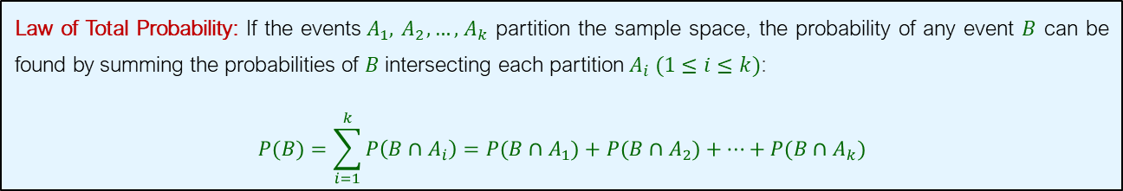

Law of Total Probability
Law of Total Probability: If the events${ A}_{1},{ A}_{2},…,{ A}_{k}$ partition the sample space, the probability of any event $B$ can be found by summing the probabilities of $B$ intersecting each partition${ A}_{i} (1≤i≤k)$:
$$P(B)=\sum_{i=1}^{k}{P\left(B∩{ A}_{i}\right)}=P(B∩{ A}_{1})+P(B∩{ A}_{2})+⋯+P(B∩{ A}_{k})$$

Slide 16









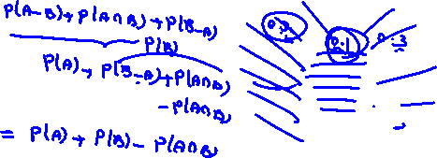


General Addition Rule
$$P(A∪B)=P(A)+P(B)−P(A ∩ B)$$
$$Sample Space (Ω)$$
$$A$$
$$B$$
$$A−B$$
$$A ∩B$$
$$B−A$$
Because $A−B, A∩B,B−A$ are disjoint events, by the definition of probability, we have:
$$P\left(A∪B\right)=P\left(A−B\right)+P\left(A∩B\right)+P\left(B−A\right)=P\left(A\right)+P\left(B−A\right)=P\left(A\right)+P\left(B\right)−P(A∩B)$$

Slide 17

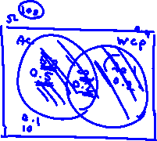




Example
Of the cars on a used car lot, $70\%$ have air conditioning (AC) and $40\%$ have a wireless charging pad (WCP). $20\%$ of the cars have both. What is the probability that a car has a CD player, given that it has WCP?

Slide 18







Solution
$$Sample Sapce (Ω)$$
$$0.1$$
$$AC$$
$$WCP$$
$$0.5$$
$$0.2$$
$$0.2$$
$$P\left(AC∪WCP\right)=P\left(AC\right)+P\left(WCP\right)−P\left(AC∩WCP\right)=0.7+0.4−0.2=0.9$$

Slide 19
Conditional Probability

Slide 20

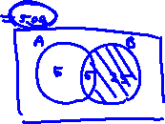






Conditional Probability
Definition: If $P\left(B\right)>0$then the conditional probability that $A$occurs given that $B$ occurs is defined to be:
$$P(A|B)=\frac{P(A∩B)}{P(B)}$$
$$B$$
$$A$$
$$B ∩ A$$

Slide 21




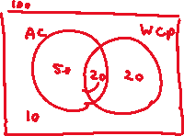
Example
Of the cars on a used car lot, $70\%$ have air conditioning (AC) and $40\%$ have a wireless charging pad (WCP). $20\%$ of the cars have both. What is the probability that a car has a CD player, given that it has WCP?

Slide 22



Solution
$$Sample Sapce$$
$$0.1$$
$$AC$$
$$WCP$$
$$0.5$$
$$0.2$$
$$0.2$$
$$P\left(WCP | AC\right)=\frac{P\left(WCP∩AC\right)}{P\left(AC\right)}=\frac{0.2}{0.7}=0.2857$$

Slide 23





Example
A family has two children. What is the probability that both are boys, given that at least one is boy?

Slide 24


Solution
$$Ω=\{BB,BG,GB,GG\}$$
$$P\left(BB | \{BB,BG,GB\}\right)=\frac{P\left(BB\right)}{P\left(\{BB,BG,GB\}\right)}=\frac{n\left(\{BB\}\right)}{n\left(\{BB,BG,GB\}\right)}=\frac{1}{3}$$

Slide 25

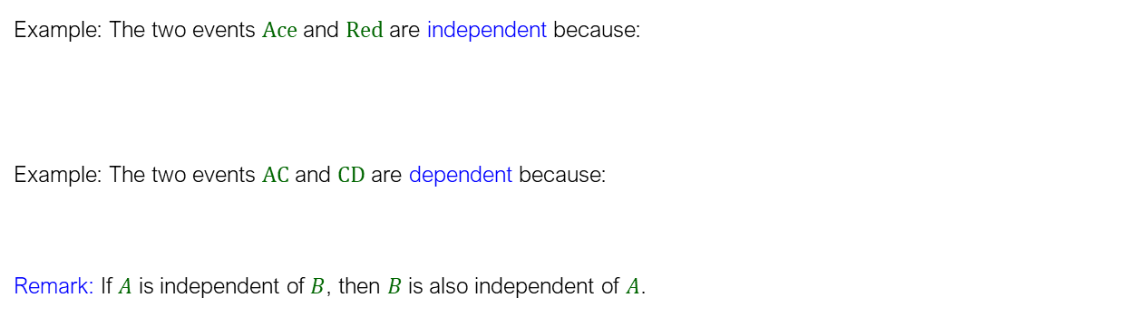


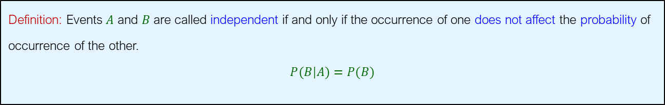



Independence
Definition: Events $A$ and $B$ are called independent if and only if the occurrence of one does not affect the probability of occurrence of the other.
$$P(B|A)=P(B)$$
Example: The two events $Ace$ and $Red$ are independent because:
Example: The two events $AC$ and $CD$ are dependent because:
Remark: If $A$ is independent of $B$, then $B$ is also independent of $A$.
$$P(Ace|Red)=P(Ace)=\frac{2}{26}$$
$$P(CD|AC)=0.28≠P(CD)=0.4$$

Slide 26


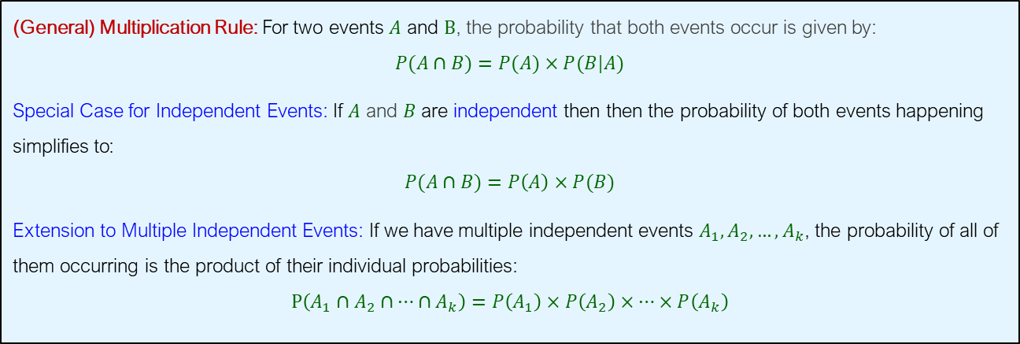


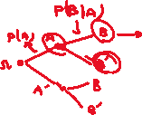

Multiplication Rule
(General) Multiplication Rule: For two events $A$ and $B$, the probability that both events occur is given by:
$$P(A∩B)=P(A)×P(B|A)$$
Special Case for Independent Events: If $A$ and $B$ are independent then then the probability of both events happening simplifies to:
$$P(A∩B)=P\left(A\right)×P(B)$$
Extension to Multiple Independent Events: If we have multiple independent events $A_{1},A_{2},…,A_{k}$, the probability of all of them occurring is the product of their individual probabilities:
$$P\left(A_{1}∩A_{2}∩…∩A_{k}\right)=P\left(A_{1}\right)×P\left(A_{2}\right)×…×P\left(A_{k}\right)$$

Slide 27
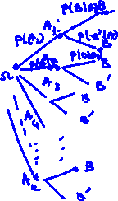










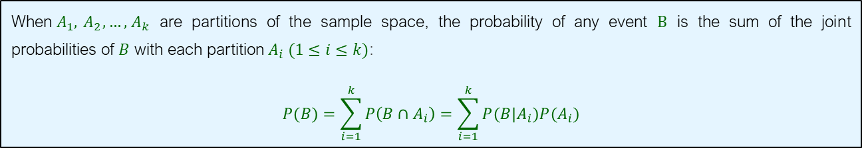





Revisiting The Law of Total Probability
When${ A}_{1},{ A}_{2},…,{ A}_{k}$ are partitions of the sample space, the probability of any event $B$ is the sum of the joint probabilities of $B$ with each partition${ A}_{i} (1≤i≤k)$:
$$P(B)=\sum_{i=1}^{k}{P\left(B∩{ A}_{i}\right)}=\sum_{i=1}^{k}{P(B|A_{i})P(A_{i})}$$

Slide 28



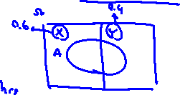


Example
Suppose that there are two factories that supply light bulbs to the market. Factory X's bulbs have a track record of working for over $5000$ hours in $99\%$ of cases, while Factory Y's bulbs meet this criterion in $95\%$ of cases. We also know that Factory X supplies $60\%$ of the total bulbs available. What is the probability that a purchased bulb will work for longer than $5000$ hours?

Slide 29
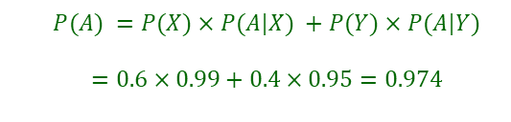





Solution
$A$: the event that a bulb lasts over $5000$ hrs
$X$: the event that a bulb is from Factory $X$
$Y$: the event that a bulb is from Factory $Y$
$$Sample Space$$
$$Factory X$$
$$A$$
$$Factory Y$$
$$P(A) =P(X)×P(A|X) +P(Y)×P(A|Y)$$ $$=0.6×0.99+0.4×0.95=0.974$$

Slide 30

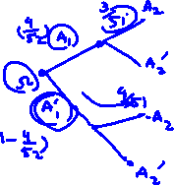





Example
When we draw two cards sequentially from a well shuffled deck, what is the probability of the second card being an ace?

Slide 31
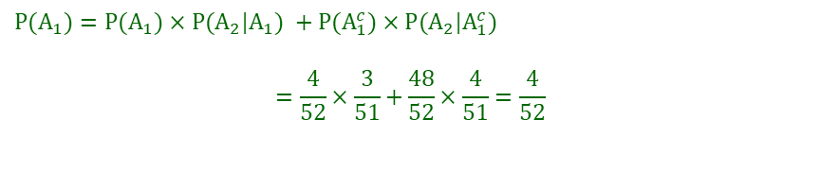





Solution
$A_{1}$: the event that the first card is an ace
$A_{2}$: the event that the second card is an ace
$$Sample Space$$
$$A_{1}$$
$$A_{1}^{c}$$
$$A_{2}$$
$$P(A_{1})=P(A_{1})×P(A_{2}|A_{1}) +P(A_{1}^{c})×P(A_{2}|A_{1}^{c})$$
$$=\frac{4}{52}×\frac{3}{51}+\frac{48}{52}×\frac{4}{51}=\frac{4}{52}$$

Slide 32




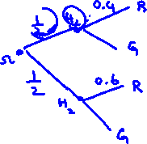








Example
We have two hats: the first has $4$ red balls and $6$ green balls, and the second has $6$ red and $4$ green. We flip a fair coin: if it lands on heads, we randomly draw a ball from the first hat, but if it lands on tails, we draw from the second hat. What is the probability that we will draw a red ball?

Slide 33
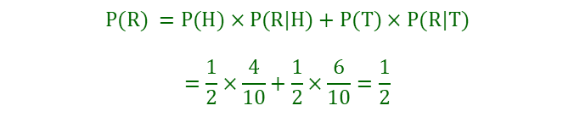





Solution
$R$: the event of drawing a red ball
$H$: the event that the coin lands on heads (drawing from the first hat)
$T$: the event that the coin lands on tails (drawing from the second hat)
$$Sample Space$$
$$P(R) =P(H)×P\text{(}R|H)+P(T)×P(R|T)$$ $$=\frac{1}{2}×\frac{4}{10}+\frac{1}{2}×\frac{6}{10}=\frac{1}{2}$$
$$H$$
$$T$$
$$R$$

Slide 34





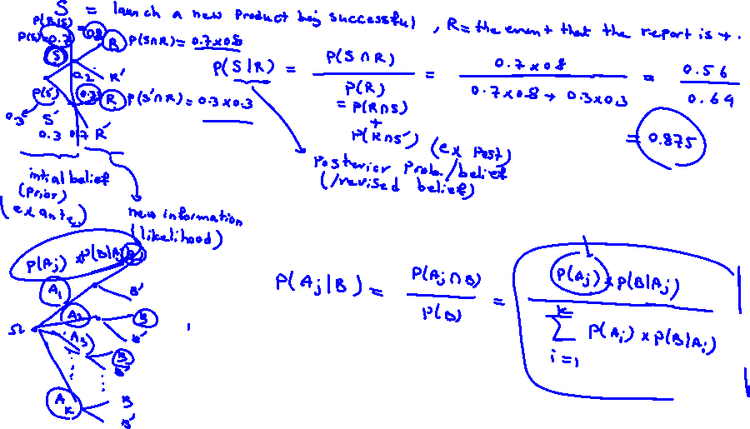

Bayes’ Theorem

Slide 35
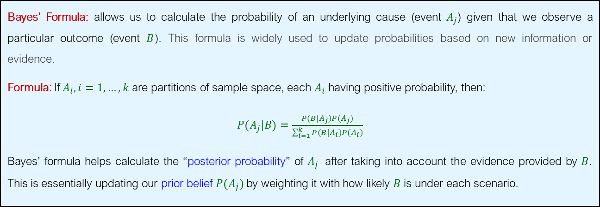
Bayes’ Formula
Bayes’ Formula: allows us to calculate the probability of an underlying cause (event $A_{j}$) given that we observe a particular outcome (event $B$). This formula is widely used to update probabilities based on new information or evidence.
Formula: If $A_{i}, i=1,…,k$are partitions of sample space, each $A_{i}$having positive probability, then:
$P(A_{j}|B)=\frac{P(B|A_{j})P(A_{j})}{\sum_{i=1}^{k}{P(B|A_{i})P(A_{i})}}$
Bayes’ formula helps calculate the “posterior probability” of $A_{j}$​ after taking into account the evidence provided by $B$. This is essentially updating our prior belief $P(A_{j})$by weighting it with how likely $B$ is under each scenario.

Slide 36



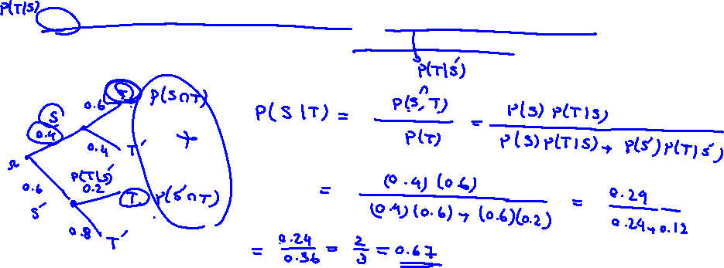

Example
A drilling company has provided an estimation of a $40\%$ chance of striking oil for their newly drilled well. In order to gather more information, a diagnostic test has been scheduled. Based on historical data, it has been observed that $60\%$ of successful wells have yielded positive test results, while $20\%$ of unsuccessful wells have also yielded positive test results. Now, considering the fact that the test for this well has come back positive, what is the probability that the well will indeed strike oil and be classified as a successful well?

Slide 37





Solution
$$Sample Space$$
Consider the two events:
$S=$ the event that the well will strike oil (success)
$T=$ the event that the test result is positive
Then:
$P\left(S\right)=0.4, P\left(S^{c}\right)=0.6$
$P\left(T|S\right)=0.6, P\left(T|S^{c}\right)=0.2$
Therefore, receiving this good increased our belief about striking the oil successfully by about $27\%$.
$$S$$
$$S′$$
$$T$$
$$P\left(S | T\right)=\frac{P\left(S∩T\right)}{P\left(T\right)}=\frac{P\left(S\right)×P\left(T | S\right)}{P\left(S\right)×P\left(T | S\right)+P\left(S^{c}\right)×P\left(T | S^{c}\right)}=\frac{0.4×0.6}{0.4×0.6+0.6×0.2}=0.67$$

Slide 38

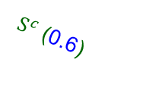
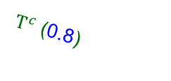
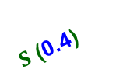

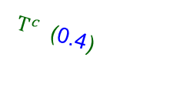


Using Decision Trees
$T$ (0.6)
$$P\left(S∩T\right)=0.4×0.6=0.24$$
$S$ (0.4)
Newly drilled well
$T^{c}$ (0.4)
$T$ (0.2)
$$P\left(S^{c}∩T\right)=0.6×0.2=0.12$$
$S^{c}$ (0.6)
$T^{c}$ (0.8)
$$P\left(S | T\right)=\frac{P\left(S∩T\right)}{P\left(T\right)}=\frac{P\left(S∩T\right)}{P\left(S∩T\right)+P\left(S^{c}∩T\right)}=\frac{0.24}{0.24+0.12}=0.67$$

Slide 39






Example
In previous cases, $40\%$ of new-model televisions have been classified as successful, while $60\%$ have been considered unsuccessful. Prior to introducing a new model television, the marketing research department conducts a comprehensive study and releases either a favorable or unfavorable report. In the past, $80\%$ of the successful new-model televisions have received favorable market research reports, whereas $30\%$ of the unsuccessful ones have received favorable reports. Now, for the new model of television currently being considered, the marketing research department has issued a favorable report. What is the probability that this television will be successful?

Slide 40


Solution
$$Sample Space$$
Consider the two events:
$S=\{successful TV model\}$
$T=\left\{positive market report\right\}$
Then:
$P\left(S\right)=0.4, P\left(S^{′}\right)=0.6$
$P\left(T|S\right)=0.8, P\left(T|S^{′}\right)=0.3$
The updated belief about the chance of the success of the new model after getting the new information is $64\%$.
$$S$$
$$S′$$
$$T$$
$$P\left(S | T\right)=\frac{P\left(S∩T\right)}{P\left(T\right)}=\frac{P\left(S\right)×P\left(T | S\right)}{P\left(S\right)×P\left(T | S\right)+P\left(S^{′}\right)×P\left(T | S^{′}\right)}=\frac{0.4×0.8}{0.4×0.8+0.6×0.3}=0.64$$

Slide 41






Using Decision Trees
$T$ (0.8)
$$P\left(S∩T\right)=0.4×0.8=0.32$$
$S$ (0.4)
New TV Model
$T^{c}$ (0.2)
$T$ (0.3)
$$P\left(S^{c}∩T\right)=0.6×0.3=0.18$$
$S^{c}$ (0.6)
$T^{c}$ (0.7)
$$P\left(S | T\right)=\frac{P\left(S∩T\right)}{P\left(T\right)}=\frac{P\left(S∩T\right)}{P\left(S∩T\right)+P\left(S^{c}∩T\right)}=\frac{0.32}{0.32+0.18}=0.64$$
41

Slide 42






Using Bayes for Spam Detection
Email Text | Label
"Cheap loans available now" | Spam
"Get cheap prices on electronics" | Spam
"Limited time offer on cheap flights" | Spam
"Cheap products for the best deals" | Spam
"Congratulations! Great deals await you" | Spam
"Looking for best restaurants nearby?" | Not Spam
“Great movie tickets available" | Not Spam
"Cheap gym memberships in town" | Not Spam

